Slide 1

WEB PROGRAMMING
Name : T.Rathinavel
Roll No: 240701423
Dept: Computer Science & Engineering
Project title: Evaluation of Academic Performance

Slide 2
ABSTRACT
The Evaluation of Academic Performance System is a web-based application designed to evaluate students' academic progress according to the minimum academic requirements defined by their degree programs.
The system analyzes the student's Overall CGPA, Major CGPA, course completion status, and individual course grades to determine their academic standing.
The evaluation is performed annually based on predefined academic regulations. Depending on the results, students are classified into categories such as Good Standing, Academic Warning, Continue in Alternate, or Dismissed from Program.
The system helps academic administrators monitor student performance, identify students who need academic support, and make consistent decisions.

Slide 3
PROBLEM STATEMENT
Educational institutions need an efficient and reliable method to evaluate students' academic performance according to the academic regulations of their degree programs.
Manual evaluation of Overall CGPA, Major CGPA, course completion, and individual course grades can be time-consuming and may lead to calculation errors, inconsistent decisions, and delays in identifying students who require academic support.
The proposed Evaluation of Academic Performance System aims to automate the annual evaluation process by comparing students' academic records with predefined program requirements.
Based on the evaluation results, the system classifies students into categories such as Good Standing, Academic Warning, Continue in Alternate, or Dismissed from Program.
The system also provides transparent evaluation results, maintains academic history, and supports administrators in making consistent, regulation-based academic decisions.

Slide 4
PROPOSED SYSTEM
The proposed system automates the academic evaluation process through the following modules:
Student Information Management: Store student details, degree programs, academic records, and course information.
Academic Rules Configuration: Allow authorized administrators to define program-specific minimum CGPA requirements, course completion criteria, and academic status rules.
Performance Evaluation Engine: Compare Overall CGPA, Major CGPA, and course-level results against the configured requirements.
Academic Status Classification: Assign an appropriate status based on institutional regulations.
Dashboard and Reporting: Display academic results, performance summaries, unmet requirements, and annual reports.
Academic History Management: Store previous evaluations to track student progress across academic years.

Slide 5
OBJECTIVES
To automate the annual evaluation of students' academic performance.
To compare Overall CGPA and Major CGPA with degree-specific minimum requirements.
To evaluate course completion and individual course grades.
To classify students into Good Standing, Academic Warning, Continue in Alternate, or Dismissed from Program.
To identify students who need academic counseling or additional support.
To improve the accuracy, consistency, and transparency of evaluation decisions.
To maintain secure academic records and historical evaluation reports.
To help administrators make informed decisions based on predefined academic regulations.

Slide 6
TECH STACK
Layer | Technologies | Purpose
Frontend | HTML5, CSS3, JavaScript | Structure, styling, and interactions
UI Framework | React.js, Bootstrap | Responsive pages, components, and dashboards
Backend | Java, Spring Boot | Business logic and evaluation rules
API | REST API | Communication between frontend and backend
Database | MySQL | Store student records, grades, CGPA, and evaluation history

Slide 7
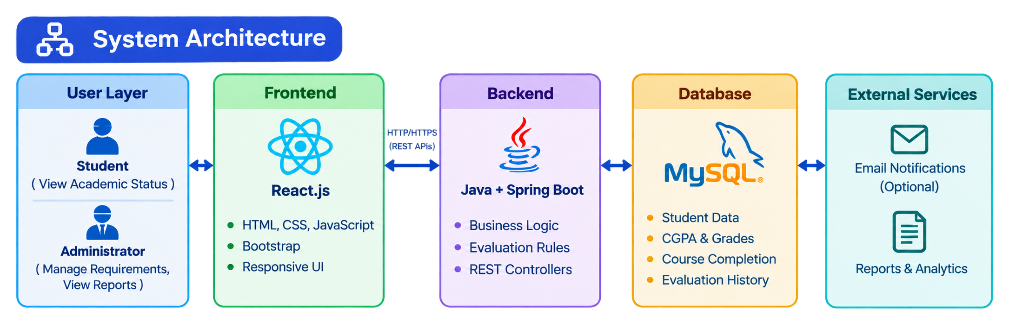
ARCHITECTURE

Slide 8
RESULTS
The project is expected to achieve the following outcomes:
Automated evaluation: Academic records are evaluated according to predefined rules.
Improved accuracy: Consistent calculations and rule-based classification reduce manual errors.
Early identification: Students who do not meet academic requirements can be identified promptly.
Transparent evaluation: Students can understand their academic status and the requirements they have not met.
Reduced workload: Administrators spend less time calculating CGPA-based outcomes and preparing reports.
Academic progress tracking: Historical records support comparison of student performance across academic years.
Better decision-making: Reports help administrators plan academic counseling, probation, and other permitted interventions.
Centralized data management: Student information, grades, academic requirements, and evaluation results are maintained in one system.

Slide 9
REFERENCE
Oracle. Java Documentation. https://docs.oracle.com/en/java/
Spring. Spring Boot Reference Documentation. https://docs.spring.io/spring-boot/
MySQL. MySQL Reference Manual. https://dev.mysql.com/doc/
React. React Documentation. https://react.dev/
MDN Web Docs. HTML, CSS, and JavaScript Documentation. https://developer.mozilla.org/
Bootstrap. Bootstrap Documentation. https://getbootstrap.com/docs/
Postman. Postman Documentation. https://learning.postman.com/docs/
GitHub. GitHub Documentation. https://docs.github.com/

Slide 10
THANK YOU

